Slide 1
Progress Made: 24th Apr – 7th May
Suit Data: Extraction from .mat -> .csv w/ statistical features
Python script and associated output files can be found at: https://github.com/dan-heaton/MSc_indiv_project/tree/master/project_files
Paper reviews of RNNs and CRFs for HAR recognition in various scenarios can be found at: https://github.com/dan-heaton/MSc_indiv_project/tree/master/paper_reviews

Slide 2
Suit Data Formats
Broadly, 3 types of data files given: joint angle, all data, and the data cube
Each of the JA and AD files are associated with 1 subject’s results and are in ‘.mat’ format (MATLAB data)
Joint angle:
Each is a .mat file of a table of dimensions: ~22k x 66
Each row is a sample (sampled at 60Hz) and each column is one dimension (x,y,z) of 1 of 22 join angles; columns as (‘feature 1 x-dim’, feature 1 y-dim’, ‘feature 1 z-dim’, ‘feature 2 x-dim’ etc.)
All data:
More complex structure, as a ‘tree’ of different additional info (e.g. comments about results, recording date, segment/joint/sensor names, etc)
However, data also stored in a table within ‘tree’ structure again with 22k samples
Instead of just joint angle values, each column corresponds to a measurement instead: includes ‘position’, ‘orientation’, ‘velocity’, ‘acceleration’, ‘angularAccel’, ‘angularVeloc’, ‘sensorFreeAcel’, ‘sensorMagnet’ and so on
Each measurement uses 1 of either segments (23), joints (22) or sensors (17) in 3D, so each measurement has either 69, 66, or 51 vals
Hence, contained within a cell of table (for one row, ‘sample’, and one column, ‘measurement’) we have 69, 66, or 51 values
Data cube:
Contains a table of file names, types (DMD or HC), walk duration, any relevant notes, etc. (must be extract into separate .csv)
Within the data cube itself, contains a table of joint angles of length ‘1x25’, with each cell representing one of the 25 tests
Each cell contains ~22k x 66 values, so each cell corresponds to a complete joint angle file of corresponding name

Slide 3
Basic Structure of ‘matfiles_analysis.py’
Idea was to do several things:
Extract data from ‘.mat’ files to another data type (e.g. ‘pandas.DataFrame’) to make it easier to work with using numpy and ML APIs
Apply some statistical analysis functions to data in new format
Write this to a new .csv output file (or existing one) to be possibly used in ML model in next part of pipeline
Script can be broken down into the following:
Bunch of global variables to set the relevant source/output dirs., names of segment/joint/sensors, names of short file names (e.g. ‘D2’, ‘HC), etc.
Functions that compute statistical features (e.g. means, variances, covariances, moving diffs, FFT, cross-covariance, etc.) w/ rounding and type handling
Three classes, one for each file type handled: ‘AllDataFile’, ‘DataCubeFile’ ‘JointAngleFile’
Each constructor takes a file name in, retrieves it from the source directory, and creates a DataFrame object from it (for AllDataFile or DataCubeFile) or reads in columns directly as lists (for JointAngleFile)
All have a ‘write_statistical_features’ method that includes analysing the total data from the file object and writing results to an output .csv
Note that only stat features of joint angles is written about joint angles for JointAngleFile and DataCubeFile objects, while does so far many other measurements in AllDataFile
Several display methods, including ‘display_3d_positions’ for AllDataFile object (dynamic plotting on 3D position values) and ‘display_diffs_plots’ for JointAngle object (plots of all 3 dimensions of 22 joints’ diff values over time)

Slide 4
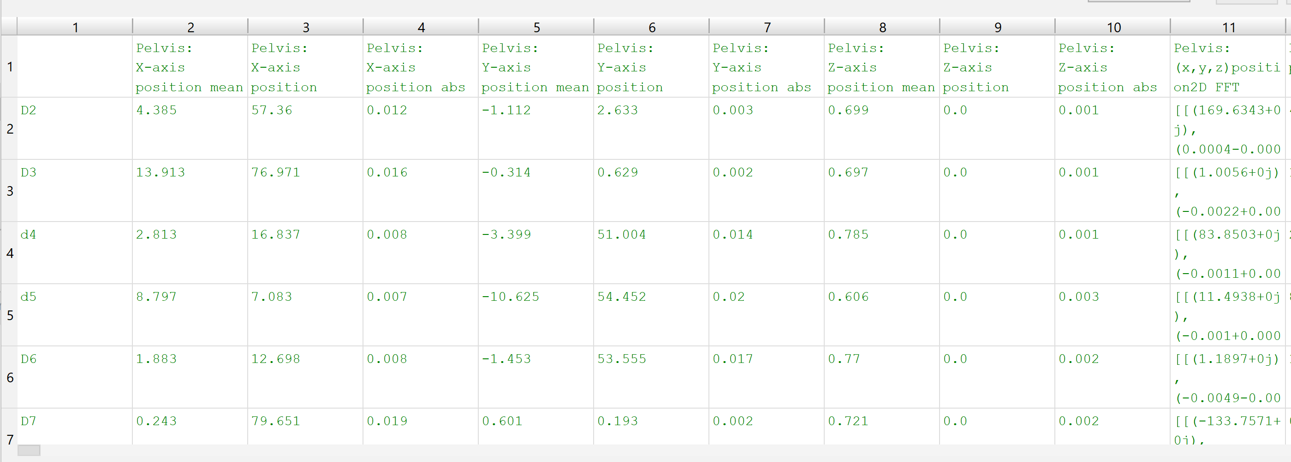
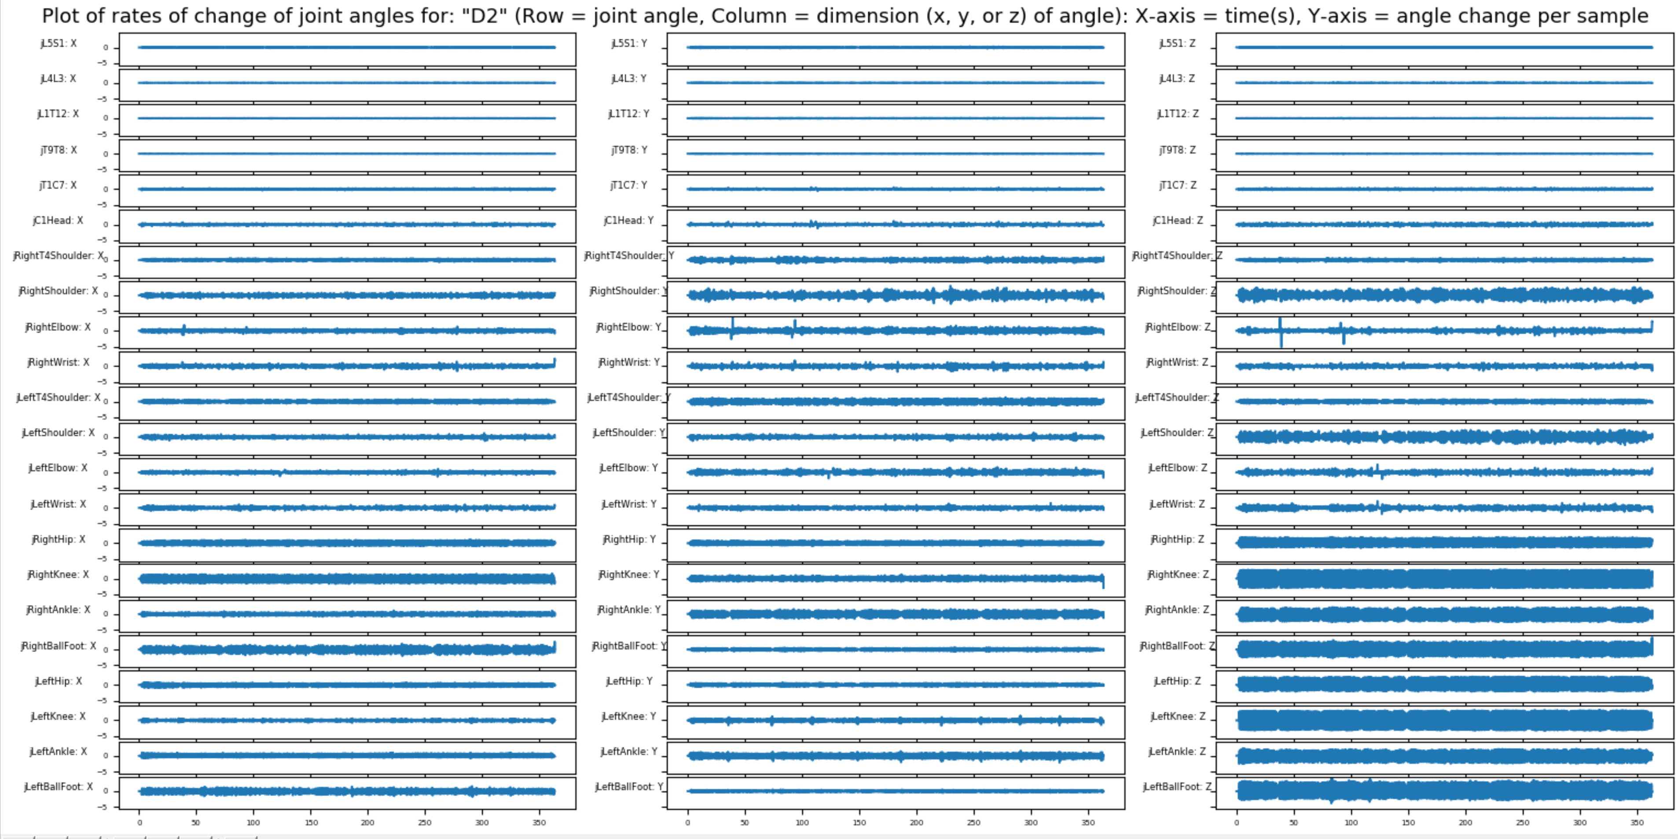
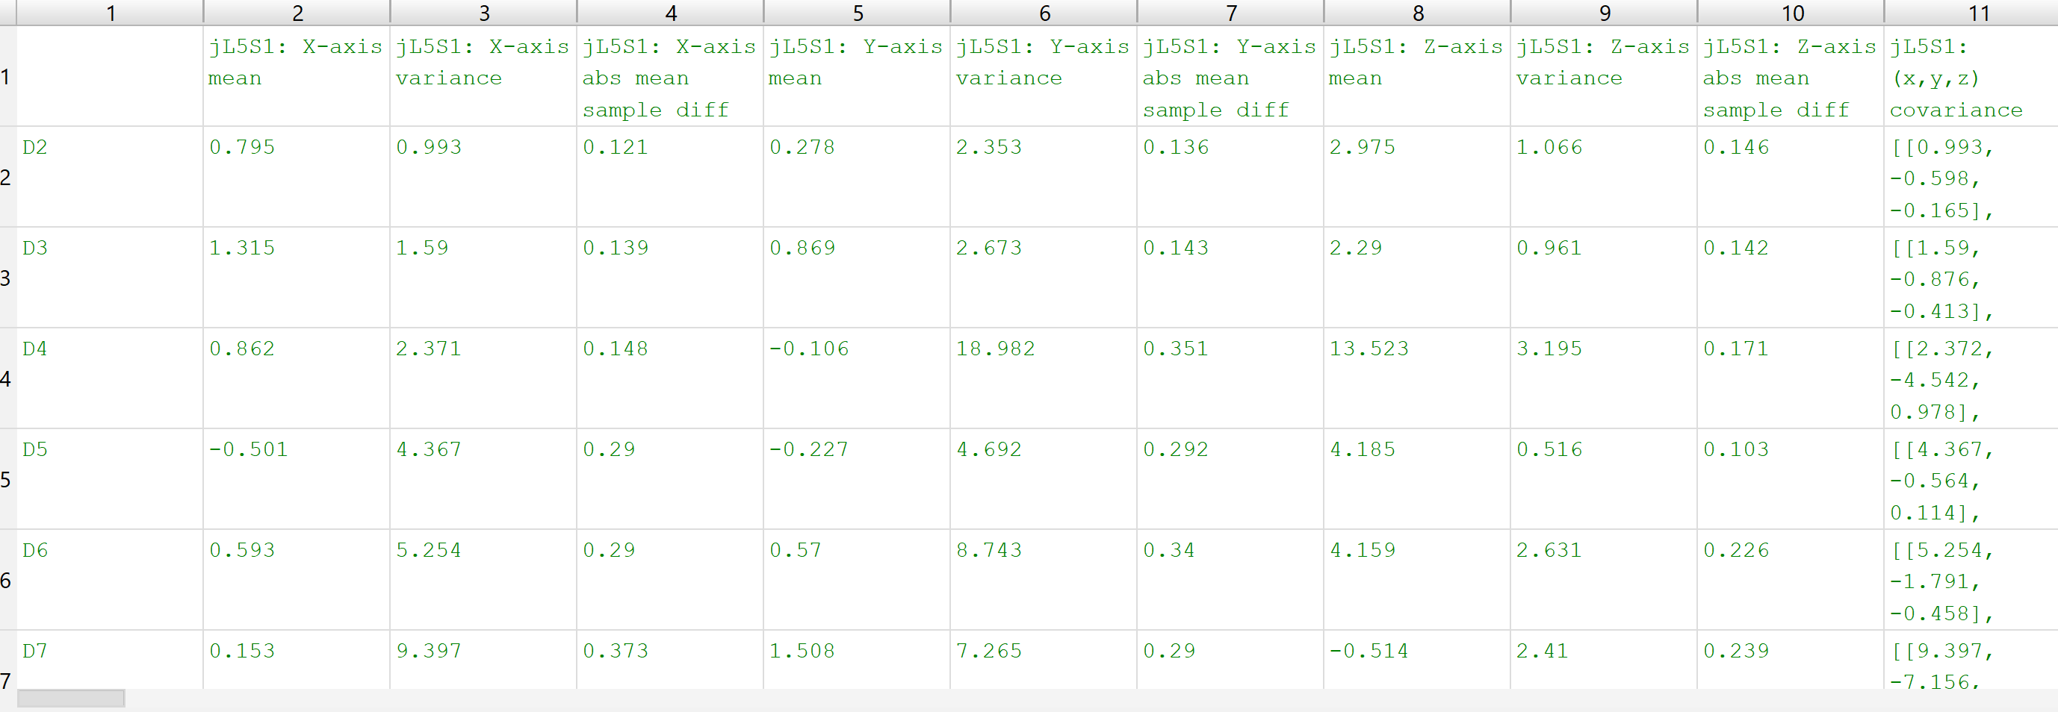
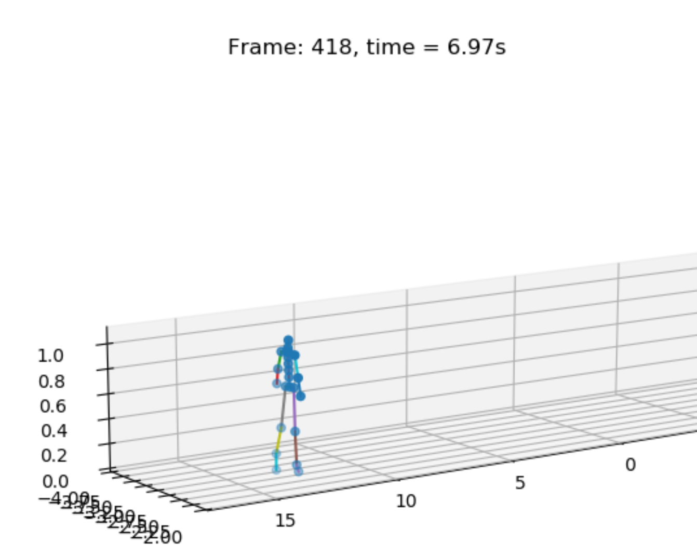
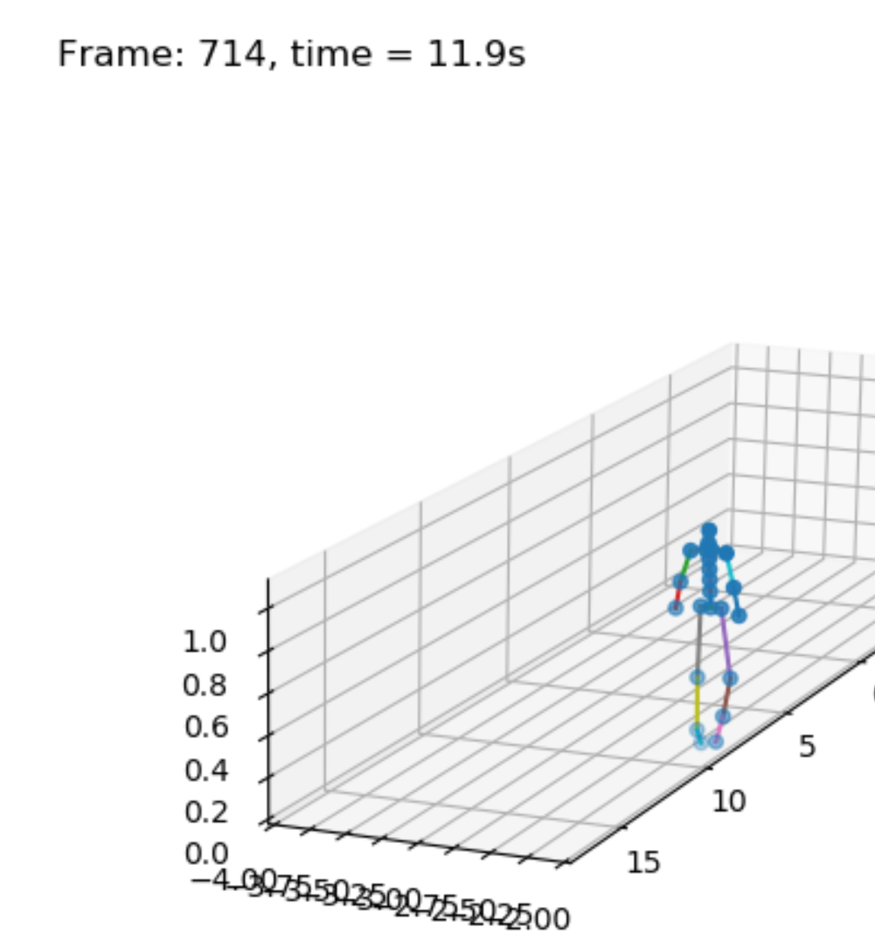
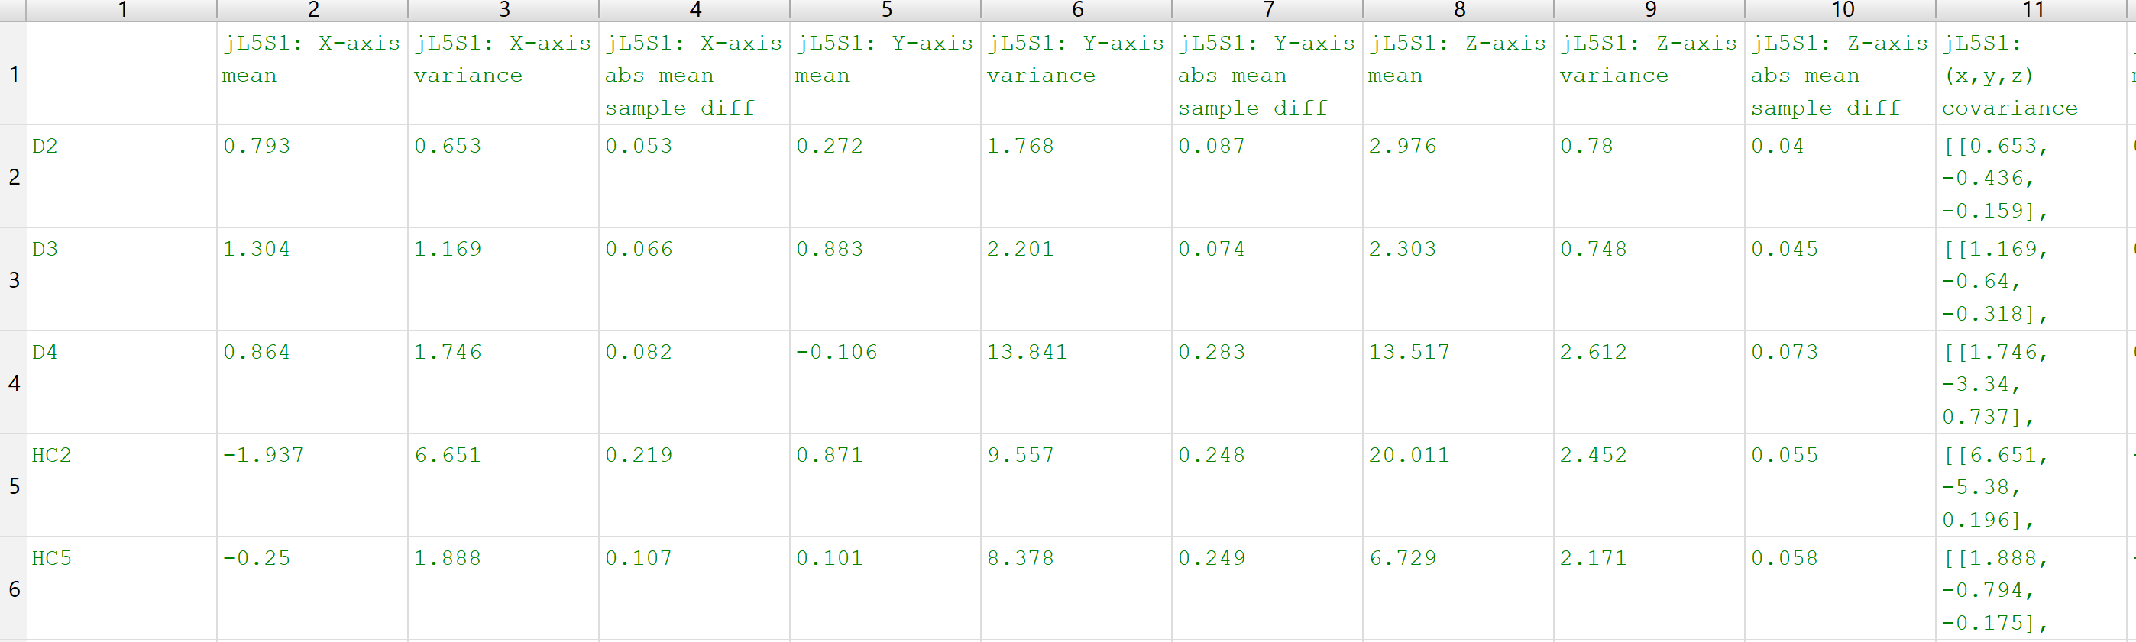
Outputs of the Script
JointAngleFile(“D2”).display_diffs_plot()
(‘AD’ vs ‘DC’ vs ‘JF’ extraction to .csv)
AllDataFile(“D2”).display_3d_positions()

Slide 5
Next Steps w/ Output
Look into basic ML models that can work with statistical features files to possibly distinguish between HC and DMB files
Must be able to work with only a few samples! (e.g. DT)
Read directly from the created .csv files
Enable script to be run from the command line
Possibly first part of data analysis pipeline
Examine different informative statistical feature extraction functions to create new info in .csv output
At same time, possibly look at ways of simplifying output .csv (avoid each row in the .csv having >1000 cols!)
Given types of file (DMD vs HC) and statistical features, can feed into basic CRF model to test prediction accuracy
“Given these statistical features of a file, can I predict if it’s a DBM or HC dataset?”
Can experiment with different features from .csv to see if certain statistical measures are more important than others
Can look also at feeding in raw measurements (e.g. joint angles over all 22k samples per file) into RNN to also look at prediction accuracy

